Slide 1
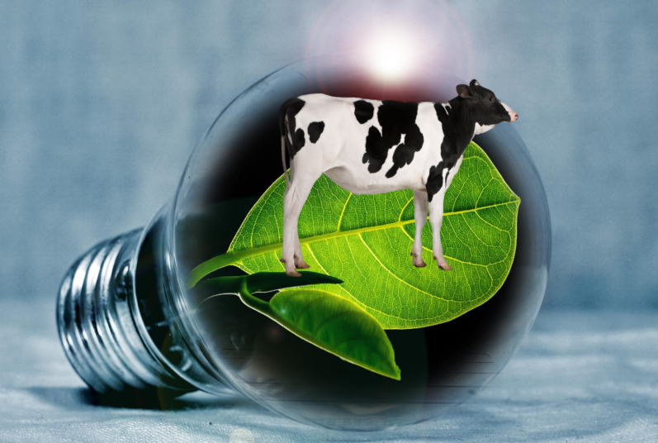
INCREASING ACCESS TO ELECTRICITY FOR PU NGAOL:
Waste to Energy

Slide 2
The Problem
Half of the population in Pu Ngaol continues to face challenges in accessing consistent and dependable electricity. Many residents resort to paying for access to electricity shared among households in their villages that are connected to the main power grid, which is expensive and unsustainable.

Slide 3
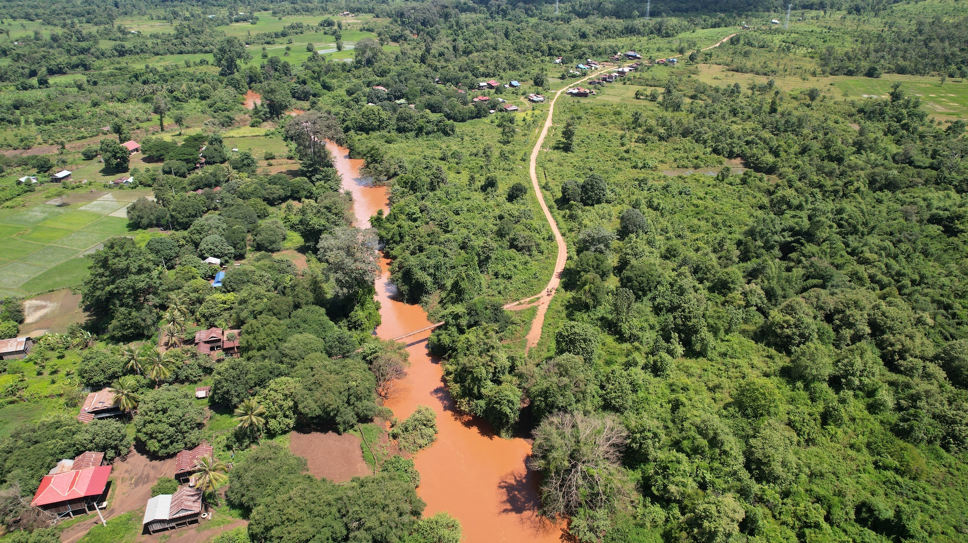
Smart Question
Is it possible to provide all residents of Pu Ngaol with access to renewable electricity (currently at 50%) within the next year, by using biodigesters, fueled with an agricultural waste and water mix?

Slide 4
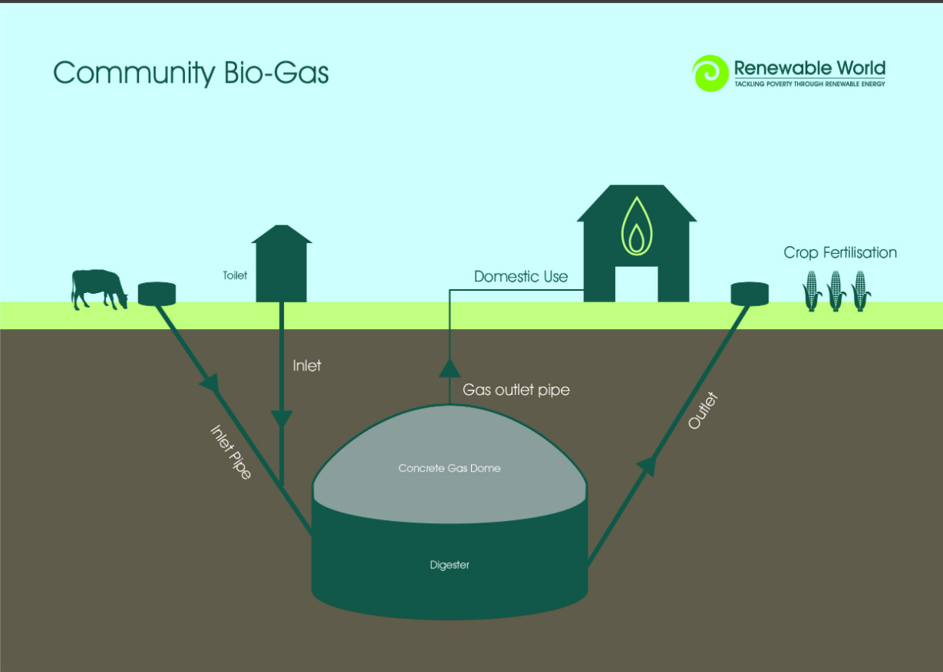
What is a biodigester?
Container with a mixture of water, manure and microbes.
Anaerobic environment
35-55 °C optimal temperature
Produces biogas (50-75% methane, 25-50% carbon dioxide, 2-8% other gases)
1m³ of biogas is 6.7kWh of energy (5 car batteries)
Digestate byproduct can be used as fertilizer

Slide 5
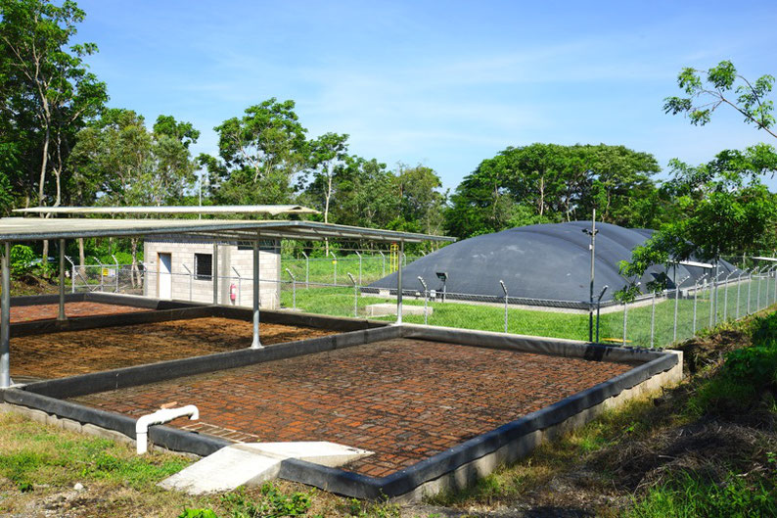
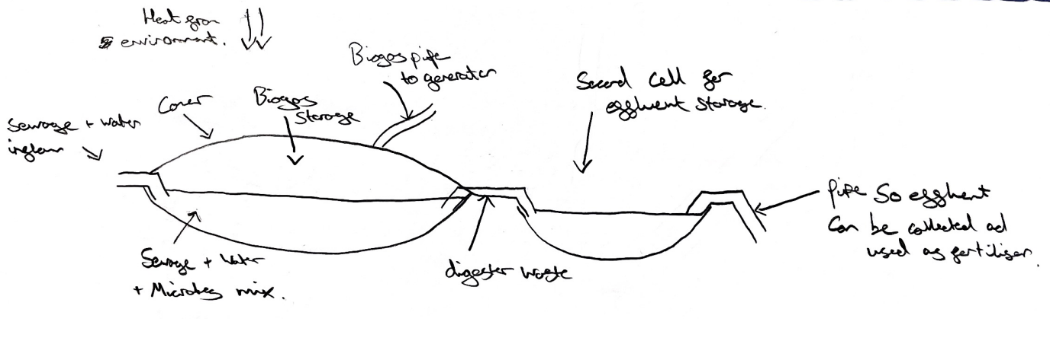
Solutions: Lagoon Bio-digester

Slide 6
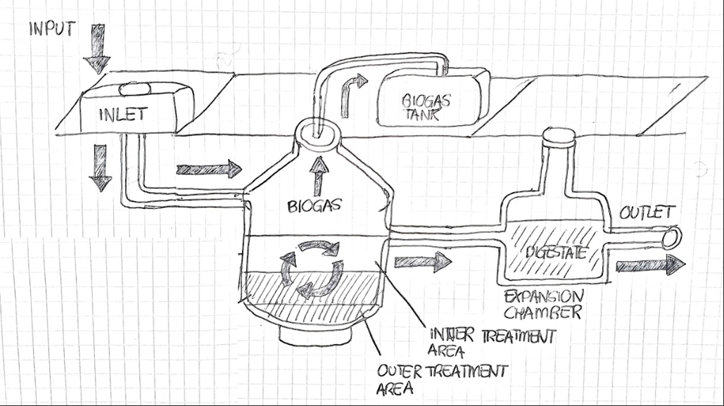
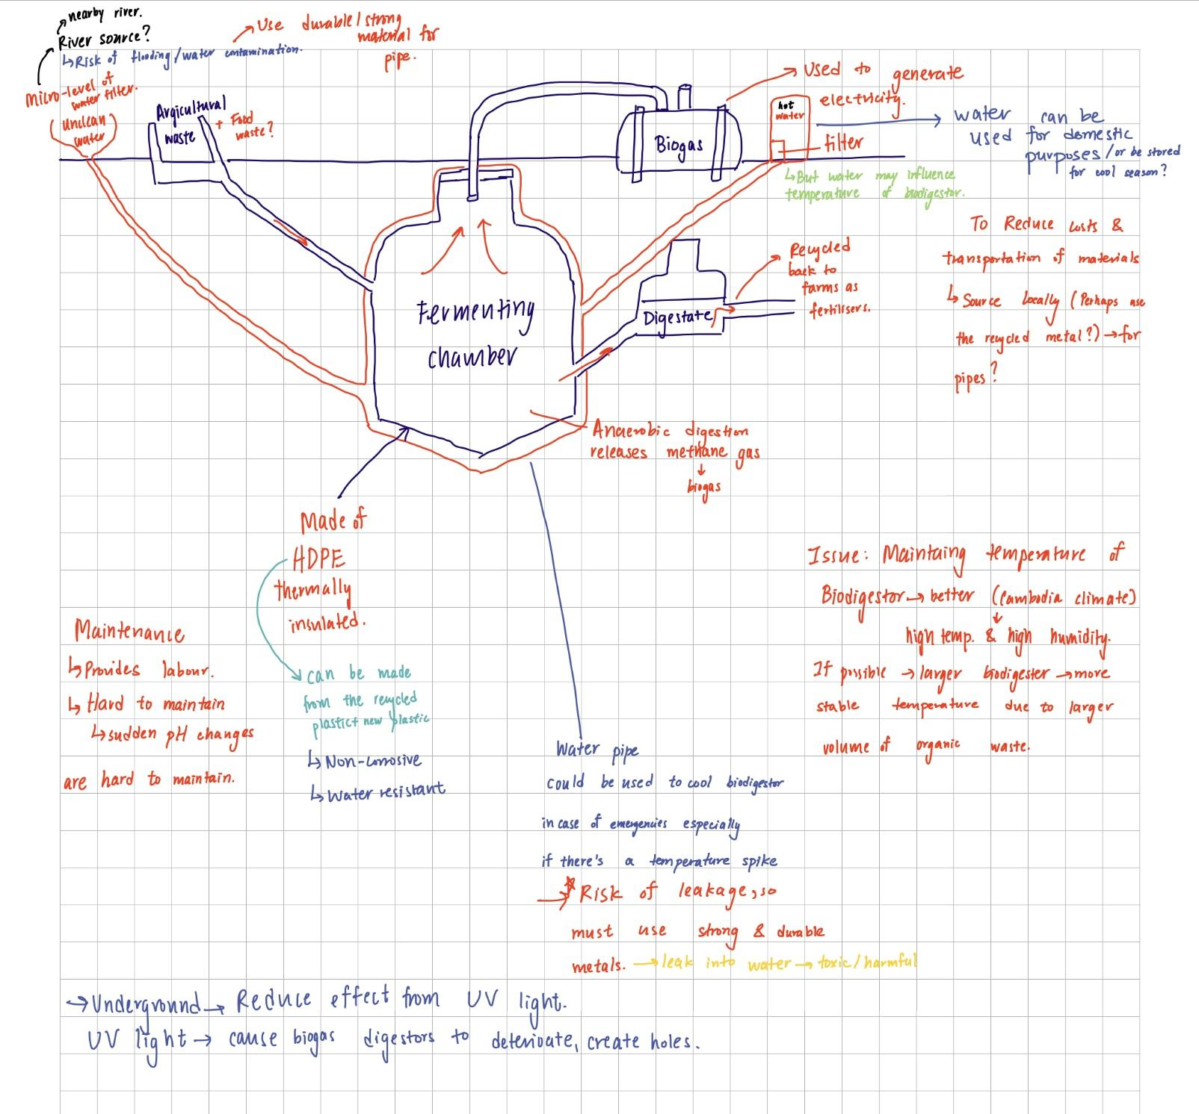
Solutions: Fixed Dome Bio-digester
SIMPLIFIED
IN-DEPTH DIAGRAM

Slide 7

Biodigester Decision Matrix
Fixed dome has the highest total so is our chosen biodigester.

Slide 8
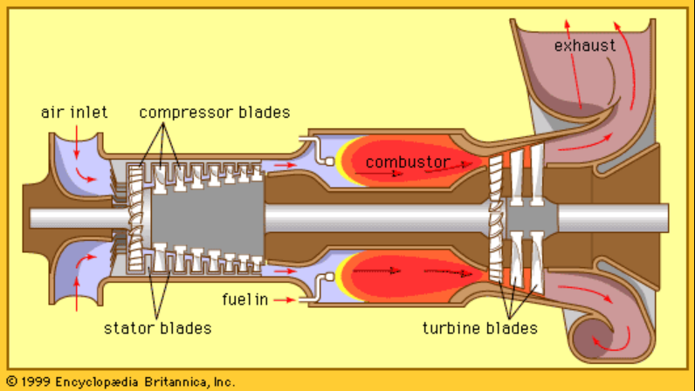
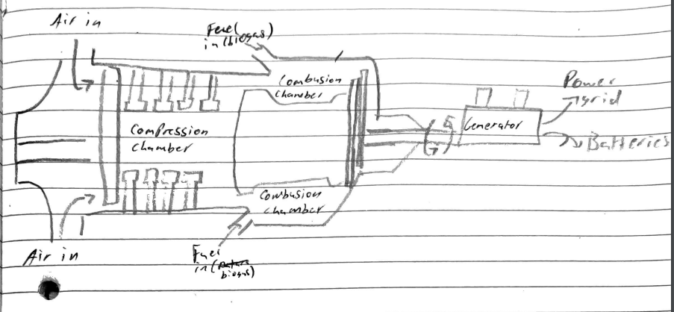
Gas Powered Turbine

Slide 9
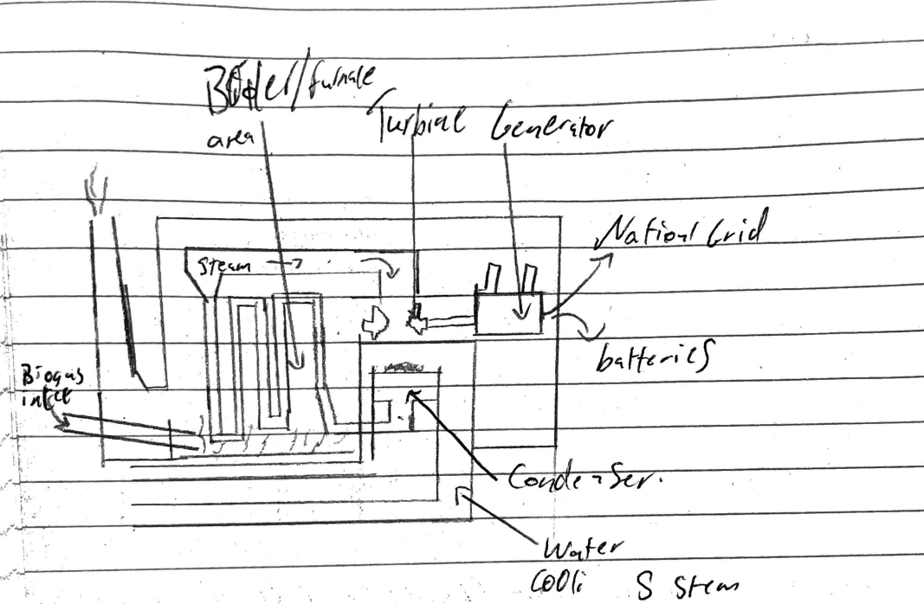
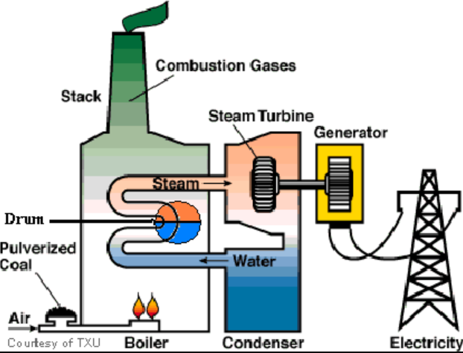
Boiler and Turbine
biogas

Slide 10
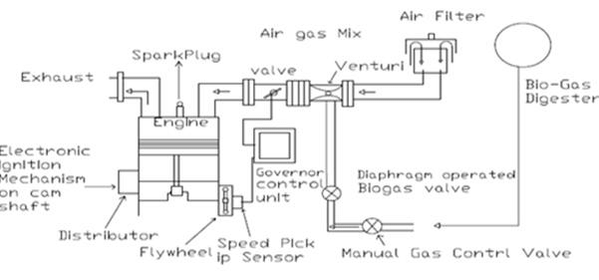
Biogas internal combustion engine (Diesel conversion)
Conversion:
Adding a spark plug
Changing the face of the piston
Relatively cheap

Slide 11

Power Generation Decision Matrix
The internal combustion engine has the highest score so we chose this as our power generation method.

Slide 12
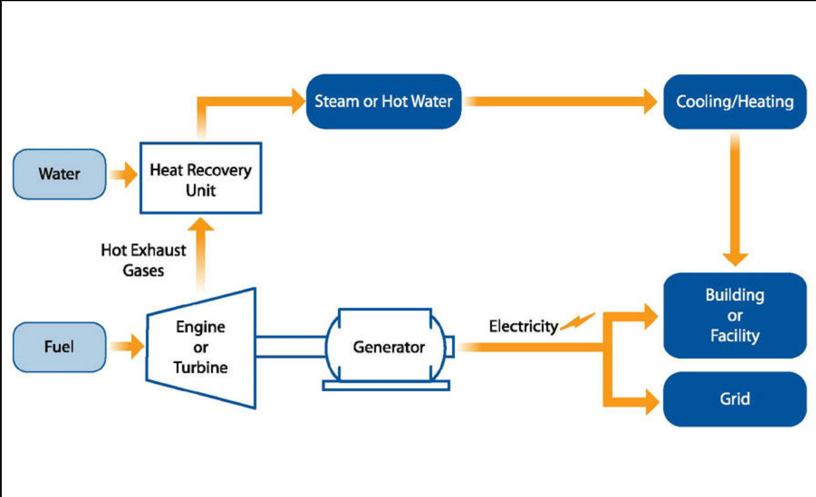
Combined Heat and Power system
Increased efficiency within our final design.
Excess Heat created by a generator and engine will be captured by the CHP.
Then used to reheat water which is redirected back into the bio-digester to maintain steady temperature (between 35-55°C).

Slide 13
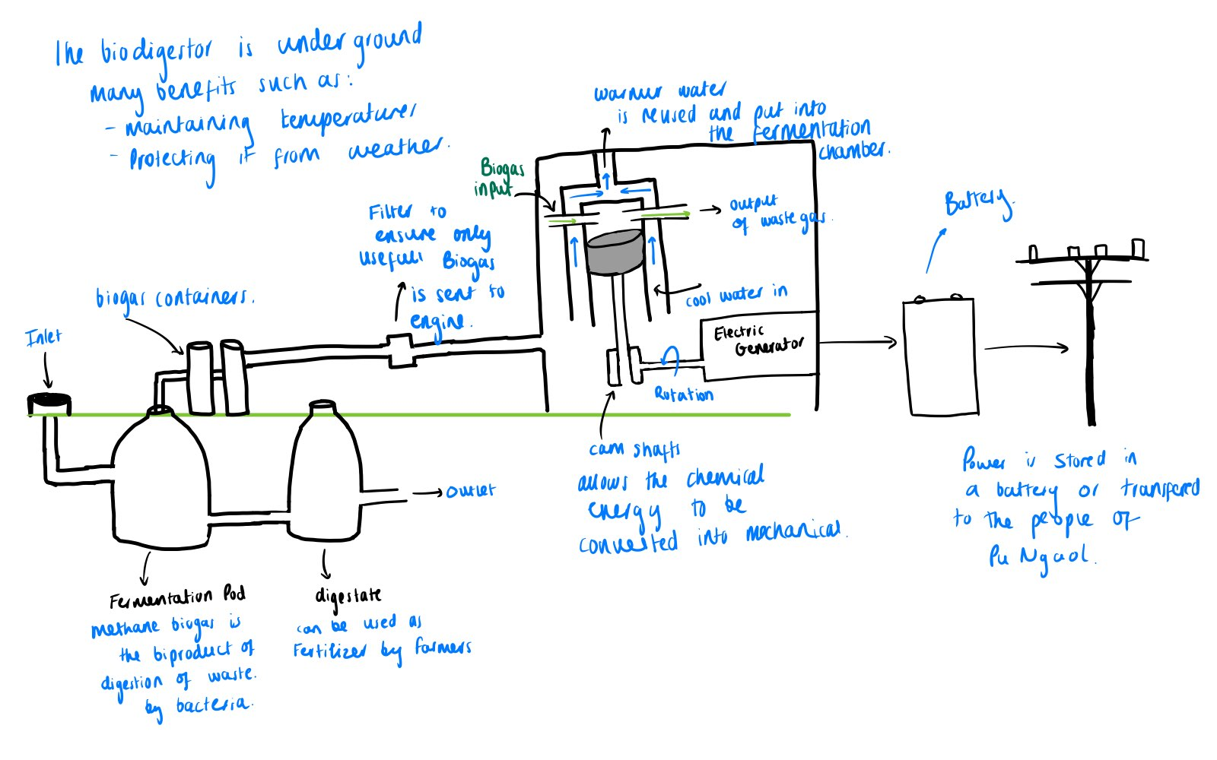
Final Combined Solution

Slide 14
social
environmental
Economical
Environmental & economical
Impacts | Solutions
Nuisance to locals (odour & sound) | Locate near river
High cost of digging biodigestor | Source of income/job for locals
River water contamination | Use materials with high compressive strength and durability
Heat dissipation from the engine→overheating | Use Combined Heat and Power system
Residual digestate leftover | Fertilisers for farmers
Release of carbon emissions | Source materials locally (reduce transportation costs & emissions)

Slide 15
Cost
2x 50m^3 biodigesters ~ £15000
100HP / 75kW engine ~ £5000-£10000 (1kWh per house) (100 phone charges)
Generator(s) ~ £2500
Water pump ~ £200
Total ~ £22700-£27700
Total Energy produced = 75 kWh per day

Slide 16
References
[3] - https://ewb.org.au/blog/2022/10/18/announcing-our-2023-ewb-challenge-community-partner/
[4] - https://www.aulafuture.org/projects/biodigester-for-the-home
[6] - https://www.en-aqualimpia.com/
[8] - 1999 Encyclopedia Britannica, inc
[9] - https://www.researchgate.net/figure/General-diagram-of-boiler-turbine-unit_fig1_260425306
[10] https://www.researchgate.net/publication/314670173_Performance_Evaluation_of_Diesel_Engine_Using_Enriched_Biogas_Review
[12] - (https://link.springer.com/article/10.1007/s10668-021-01443-8)
[13] - https://www.epa.gov/chp/what-chp

Slide 17
Thank you for listening
Any questions?

